Slide 1
Long-Term Food and Water Storage
Warren County CERT
June 22, 2021

Slide 2
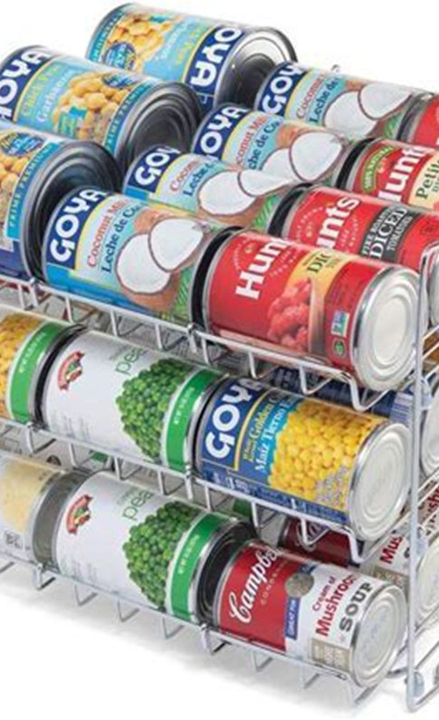
Long-term Food Survival
Make a plan and decide how long you want to store food
Decide where you are going to store your food
Decide what sort of emergencies you might be facing
Probably everyone should have a 72-hour emergency supply of food
Without a plan you will likely not be successful as it takes resources, determination and space to store food long-term
Make a list of foods that you want to store.
Your list is part of your plan and is a long-game as it is nearly impossible to gather enough food in a short period of time to store long-term.

Slide 3
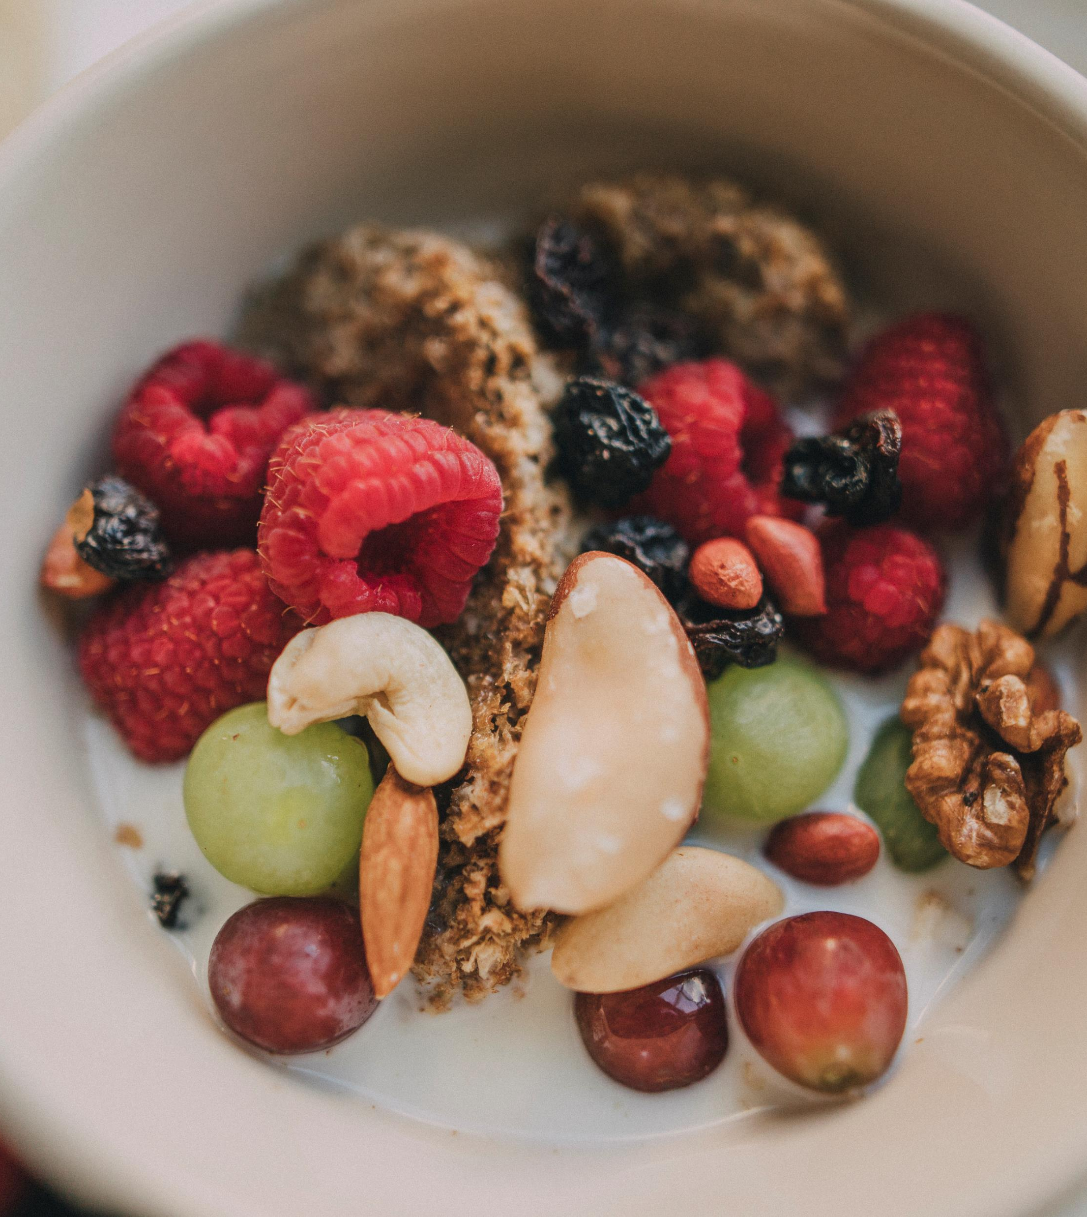
Survival Food
Food needs to be attractive and exciting. i.e., use different types of grains, legumes and pastas
You need variety; not same old; same old
Use spices and condiments
Need essential nutrients
If you don’t like something now, you will not like it later so don’t waste space storing it

Slide 4
Long-term Food Survival Tips
Have a manual can opener
Need some kind of camp stove, grill, fire pit, etc.
Hard to store meat long-term so will need to supplement your protein with canned meats, jerky, protein powder and protein bars.
Use a first in first out methodology to make sure you rotate your food goods
Moisture, air and microbes affect shelf-life of food

Slide 5
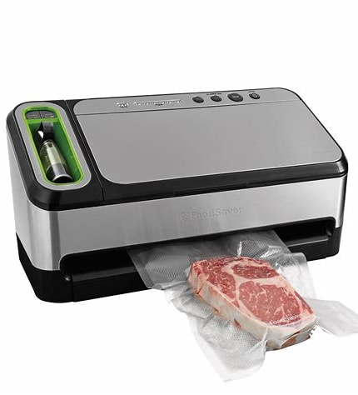
Types of Food Preservation: Vacuum Sealing
Reduces air, reduces food spoilage leading to increased shelf life
Use a commercial vacuum sealer
Place food in a mylar or aluminum bag, place the bag in water, water pressure forces the air out
Place bag/bottle in a bucket of dry ice. The carbon dioxide forces out the air

Slide 6
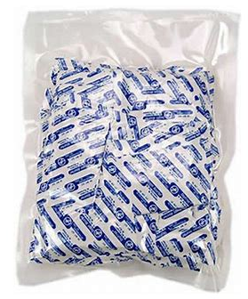
Types of Food Preservation: Oxygen Absorbers
More effective than vacuum sealing
Contain iron powder but do not allow the powder to escape
Buy “safe for human use”
Good for high humidity environments where there is a greater chance of oxidation

Slide 7
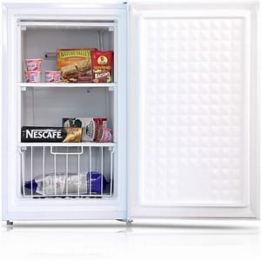
Types of Food Preservation: Freezing
One of the most effective methods for extending shelf life
Keeps meats, dairy, fruits and vegetables good for up to 3 months
Texture, taste and nutrients of the food are preserved

Slide 8
Types of Food Preservation: Desiccants
Silica gel packets remove moisture unlike oxygen absorbers that remove oxygen
Places that have high humidity makes it difficult to remove the moisture from the food

Slide 9
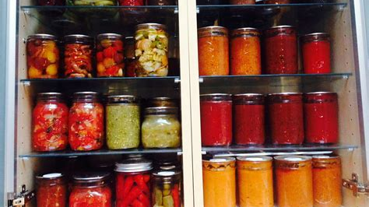
Types of Food Preservation: Pickling
Traditional method for preserving fruits and vegetables
It does not allow for microbial growth
Food is submerged in a liquid containing salt, spices, sugar or citric acid
Foods take on a rich concentrated flavor

Slide 10
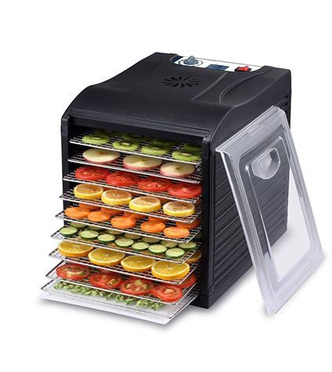
Types of Food Preservation: Dehydration
Removes all moisture from food
Used for vegetables, meat, spices and fruit
Extends shelf life by reducing microbial growth
Taste and texture of food changes
Food is kept at such a low temperature that moisture is removed but food is not cooked
More surface area (thin slices) more moisture will be removed
Thinner makes more crunchy; thicker more chewy
Dehydrator works best; direct sunlight only for peppers and a few other vegetables

Slide 11
Types of Food Preservation: Smoking
Another form of dehydration but use smoke
Usually done for meat
Takes a long time

Slide 12
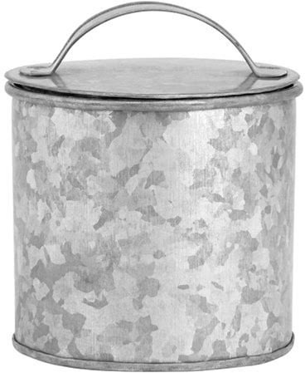
Food Storage Containers: Aluminum Cans
Come in various sizes
Can be used for dry or low oil shelf stable foods
E.g. dried apple slices, dry onions, flour
Their downside is rusting in a high humidity environment

Slide 13
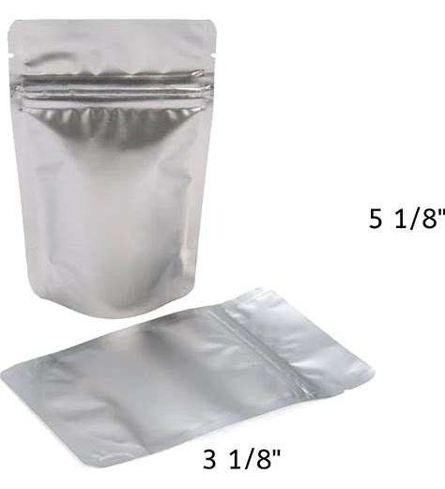
Food Storage Containers: Aluminum Foil/Mylar Pouches
Come in a variety of sizes
Once sealed do not allow moisture insects, light or air to enter
Can also place in larger plastic containers to keep rodents away
For instance, if properly sealed with an oxidizer packet flour can stay stable for 25 years.

Slide 14
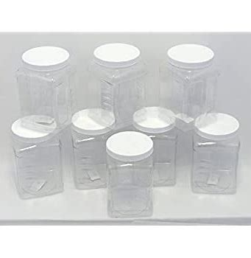
Food Storage Containers: PETE/PET (Polyethylene terephthalate) plastic bottles
Good for dry food products
Should not use other plastics as they cannot predictably prevent moisture and oxygen
Food should only have 10% moisture content or less
For instance, popcorn has about 13.5% water content
Used soda pop bottles or other PETE/PET bottles that have
previously been used for food

Slide 15
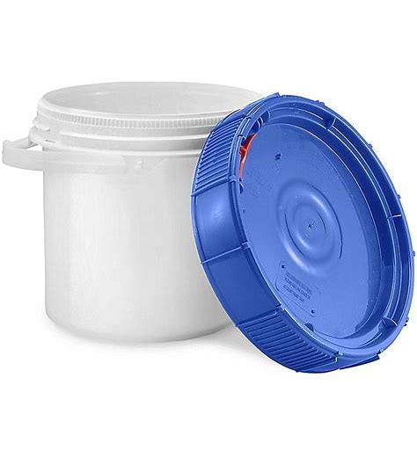
Food Storage Containers: Plastic Buckets
Use only food-grade plastic buckets that have not been used for other storage
These are used for bulk storage of grains or can be used to store mylar pouches
When used for grain storage there is a possibility for insect growth if leave in a humid environment for a long duration of time

Slide 16
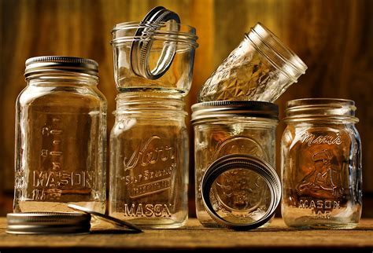
Food Storage Containers: Glass containers
Glass will not react with food
Has zero chance of contamination as moisture cannot get through
Lids are designed with a sealable gasket
Good for storing liquid or dry foods

Slide 17
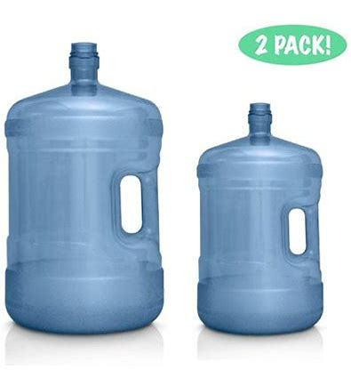
Water Storage
1 gallon/person/day
Bottled water may be easiest and safest
Keep at least a 2-week supply
If storing non-store-bought water, put in clean, new food-grade containers
Water-grade bottle usually blue
Use a tightly closed cap with a narrow neck for easier pouring

Slide 18
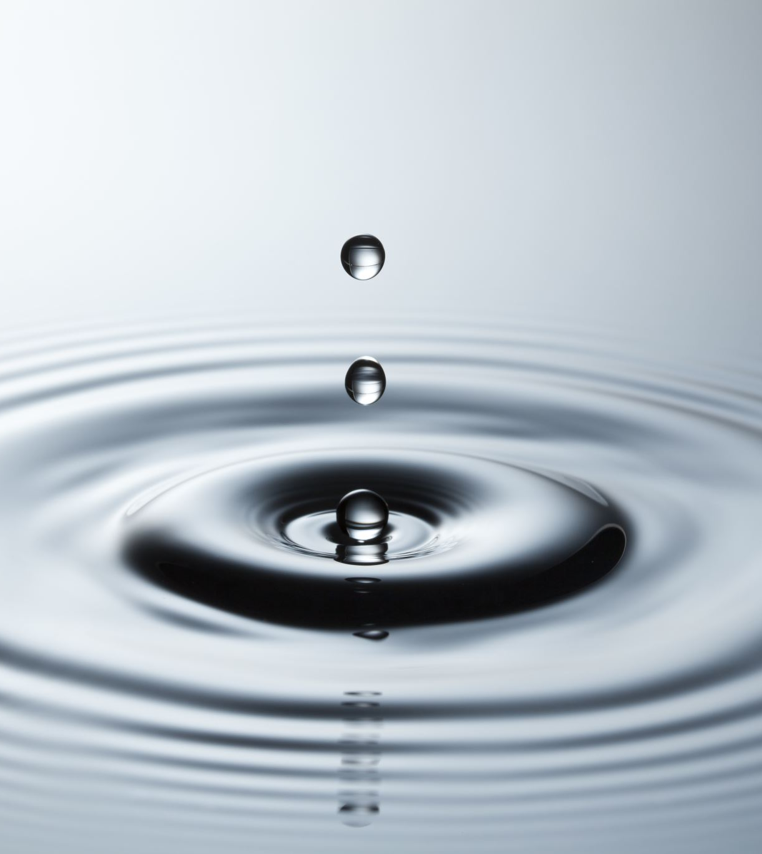
Sanitizing Water Container
Wash the container and rinse with water
Sanitize the container with a solution of 1 tsp odorless bleach (5% sodium hypochlorite) in one quart of water
Shake the container in all directions to distribute the bleach solution
Wait 30 seconds then pour out the bleach solution
Let the container air dry or rinse with clean water
Pour in your water and close the cap tightly

Slide 19
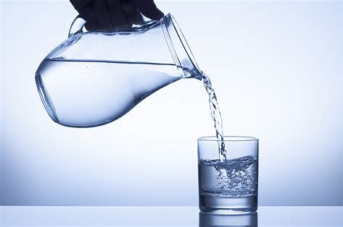
Pouring Water
Make sure you do not contaminate the container when you pour water from it.
Do not touch the spout
If you use a cup to take out the water from a large container such as a bucket, make sure to sanitize the cup before placing in the water
Ensure you do not touch the insides of the container with any part of your body

Slide 20
Safety Tips
Label your water container with what it is and a date
Water can only be stored around 6 months before it needs to be replaced
Keep in a cool place and out of direct sunlight
Do not store near other chemicals
Never use a container that has been used for other things

Slide 21
Water Purification Methods
Boiling – is the simplest and easiest method
Water Purifier – Has UV, UF and carbon filters to remove impurities
Reverse osmosis – not used so much anymore
Chlorination – Mix in ½ tsp (2.5 mL) of unscented, additive-free bleach for every 5 gallons of water. Double the amount of bleach if the water is cloudy or discolored. Let the water sit for half an hour. If you cannot smell a faint chlorine scent, repeat treatment and let sit another 15 minutes.
In an emergency, you can also disinfect small amounts of water with water purification tablets. However, use these sparingly, as excessive use can impair thyroid function
Distillation – This is a complicated process that is not easily done at home
Solar purification – Water is stored in food grade containers and placed in direct sunlight. The containers are placed in a horizontal position and shaken to activate the oxygen

Slide 22
Questions and Comments
C

